Slide 1


資料庫實務
109-1四資工二A
4080E007 蔡德龍

Slide 2





01
点击此处添加章节标题
目录
contents
02
点击此处添加章节标题
03
点击此处添加章节标题
04
点击此处添加章节标题

Slide 3
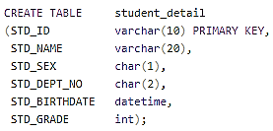
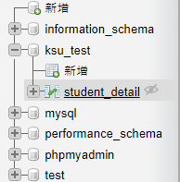
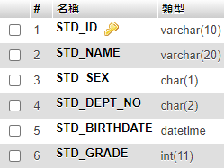
CREATE TABLE
CREATE TABLE：
CREATE TABLE “表格名” (“欄位 1” “欄位 1 資料種類”, “欄位 2” “欄位 2 資料種類", ... );
建立資料表

Slide 4
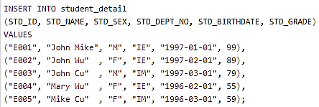
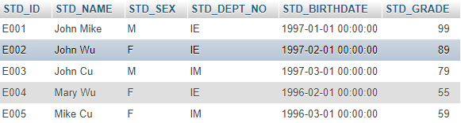
INSERT TABLE
INSERT TABLE：
INSERT INTO "表格名"
("欄位1", "欄位2", ...)
VALUES ("值1", "值2", ...);
新增資料

Slide 5

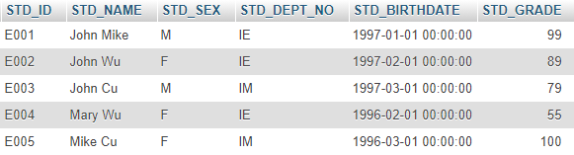
UPDATE
UPDATE：
UPDATE "表格名"
SET "欄位1" = [新值]
WHERE "條件";
更新資料

Slide 6

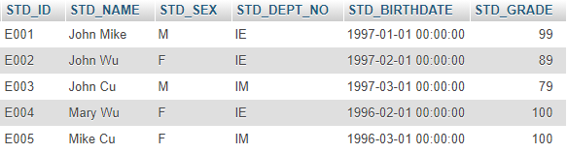
UPDATE
UPDATE：
UPDATE "表格名"
SET "欄位1" = [新值]
WHERE "條件";
更新資料

Slide 7

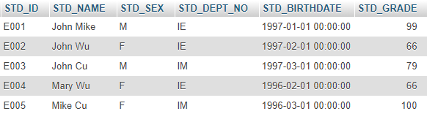
UPDATE
UPDATE：
UPDATE "表格名"
SET "欄位1" = [新值]
WHERE "條件";
更新資料

Slide 8
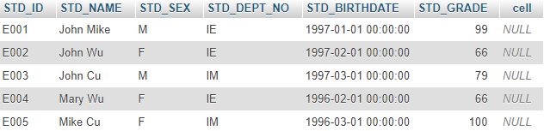
ALTER TABLE
ALTER TABLE：
ALTER TABLE "table_name"
[改變方式];
新增欄位

Slide 9
ALTER TABLE
ALTER TABLE：
ALTER TABLE "table_name"
[改變方式];
刪除欄位

Slide 10
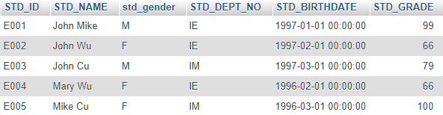
ALTER TABLE
ALTER TABLE：
ALTER TABLE "table_name"
[改變方式];
更改欄位名稱 與 型別

Slide 11
ALTER TABLE
ALTER TABLE：
ALTER TABLE "table_name"
[改變方式];
更改欄位名稱 與 型別

Slide 12

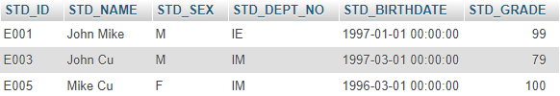
DELETE FROM
DELETE FROM：
DELETE FROM "表格名"
WHERE "條件";
刪除資料

Slide 13
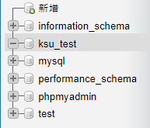
DROP TABLE
DROP TABLE：
DROP TABLE "表格名";
刪除資料表

Slide 14
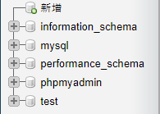
DROP TABLE
DROP TABLE：
DROP TABLE "表格名";
刪除資料庫

Slide 15

LIKE
LIKE：
SELECT * FROM Store_Information WHERE store_name LIKE '%AN%';
SELECT "欄位名"
FROM "表格名"
WHERE "欄位名" LIKE {模式};
模糊查詢

Slide 16

DISTINCT
DISTINCT：
SELECT DISTINCT "欄位名"
FROM "表格名";
SELECT DISTINCT Store_Name FROM Store_Information;
不重複資料

Slide 17

COUNT
COUNT：
SELECT COUNT (Store_Name) FROM Store_Information WHERE Store_Name IS NOT NULL;
SELECT COUNT("欄位名")
FROM "表格名";
計算表格內有多少筆資料

Slide 18
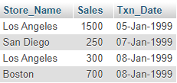

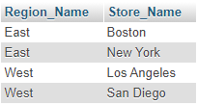

SQL表格連結(Join)
Store_Information
Geography
表格連結

Slide 19
連結兩個以上的資料表格
※ 連結的欄位：
◎ 同屬性 ◎ 同型別，同長度
SELECT ksu_std_name, ksu_std_department, dept_name FROM ksu_std_table as a, dept_detail as b WHERE a.ksu_std_department = b.dept_id
新增簡稱，資料多時方便使用

Slide 20
連結兩個以上的資料表格
※ 連結的欄位：
◎ 同屬性 ◎ 同型別，同長度
SELECT ksu_std_name, ksu_std_department, dept_name FROM ksu_std_table, dept_detail WHERE ksu_std_department = dept_id
去掉簡稱，依樣可以執行

Slide 21
混淆 簡稱(一)
※ 連結的欄位：
◎ 同屬性 ◎ 同型別，同長度
SELECT ksu_std_name, a.ksu_std_department, dept_name FROM ksu_std_table as a, dept_detail as b WHERE a.ksu_std_department = b.ksu_std_department
混淆，簡稱(一)
Notes:
SELECT ksu_std_name, a.ksu_std_department, dept_name FROM ksu_std_table as a, dept_detail as b WHERE a.ksu_std_department = b.ksu_std_department

Slide 22
混淆 簡稱(二)
※ 連結的欄位：
◎ 同屬性 ◎ 同型別，同長度
SELECT a.ksu_std_name, a.ksu_std_department, b.dept_name FROM ksu_std_table as a, dept_detail as b WHERE a.ksu_std_department = b.ksu_std_department
混淆，簡稱(二)

Slide 23
計算各系別欄位(個數)
※ 連結的欄位：
◎ 同屬性 ◎ 同型別，同長度
SELECT ksu_std_department, COUNT(*) as 個數 FROM `ksu_std_table` WHERE ksu_std_department = "IE" OR ksu_std_department = "IM" GROUP BY ksu_std_department
計算各系別欄位(個數)

Slide 24
計算各系別欄位(個數) - 簡數
※ 連結的欄位：
◎ 同屬性 ◎ 同型別，同長度
SELECT a.ksu_std_department, COUNT(*) as 個數 FROM ksu_std_table as a, dept_detail as b WHERE a.ksu_std_department = b.ksu_std_department GROUP BY a.ksu_std_department
計算各系別欄位(個數) - 簡數

Slide 25
PHP連接SQL
<?php $name=str_replace("'","''",$_REQUEST['name']); $id=str_replace ("'","''",$_REQUEST['id']);
$db_host = "localhost"; $db_name = "ksu_database"; $db_table = "ksu_cstd_table";
$db_user = "root"; $db_password = ""; $conn = mysqli_connect($db_host, $db_user, $db_password); if(empty($conn)){ print mysqli_error ($conn); die ("無法對資料庫連線！" ); exit; } if(!mysqli_select_db( $conn, $db_name)){ die("資料庫不存在!"); exit; } mysqli_set_charset($conn,'utf8');
$result = mysqli_query($conn,"SELECT * FROM ksu_std_table where ksu_std_name = '$name' or ksu_std_id = '$id'"); echo "<table border='1'> <tr> <th>ksu_std_name</th> <th>ksu_std_id</th> <th>ksu_std_age</th> </tr>";
while($row = mysqli_fetch_array($result)) { echo "<tr>"; echo "<td>" . $row['ksu_std_name'] . "</td>"; echo "<td>" . $row['ksu_std_id'] . "</td>"; echo "<td>" . $row['ksu_std_age'] . "</td>"; echo "</tr>"; } echo "</table>"; echo "records found!"; ?> <form enctype="multipart/form-data" method="post" action="ksu_select.html"> <input type="submit" name="sub" value="返回"/> </form>

Slide 26
<!doctype html>
<html lang="zh_tw">
<head>
<meta charset="utf-8">
<title>Hello</title>
</head>
<body>
<h3> ksu select operation </h3>
<form enctype="multipart/form-data" method="post" action="ksu_select.php">
學生姓名:<input type="text" name="name" size="10"/><br/>
學生學號:<input type="text" name="id" size="10"/><br/>
<input type="submit" name="sub" value="查詢"/>
</form>
</body>
</html>
PHP網頁程式碼 - 連結PHP

Slide 27
Frontend+Backend
前端程式 ：ksu_select.html
給使用者看，且與後端程式連結
後端程式 ：ksu_select.php
在伺服器上運作，且與資料庫連結的程式，因SQL被植入php中，事實上與資料庫連結的程式是SQL.
資料庫：MySQL
Server(伺服器)：Apache
高階程式語言：C#、C++、PHP、Java、Ruby、Python、Deliphi、Android Java ‥‥‥
植入SQL：SQLine、DBMS ‥‥‥
PHP放置位置
C:\xampp\htdocs
http://localhost
http://localhost/ksu_select.html
Frontend+Backend

